Slide 1
Consumer Aware Warehouse Management
SDMay20-25
Advisor: Goce Trajcevski
Client: Jimmy Paul, Crafty LLC. CTO
Team: Lindsey Sleeth, Omair Ijaz, Andrew Smith, Sam Stifter, Jameel Kelley, Elijah Buscho, Devin Üner
http://sdmay20-25.sd.ece.iastate.edu/
Notes:
Hi we are SDMay20-25 and we are working on Consumer Aware Warehouse Management. [everyone introduce themselves]

Slide 2
Client Background - Lindsey
Crafty LLC helps companies enhance their employees life at work by providing offices with food, beverage, and event management
SDMay20-25, Consumer Aware Warehouse Management
Notes:
To start us off today, I’ll be providing some background on our client. Our team is working with Chicago based company Crafty. Crafty’s mission is to help companies enhance their employees life at work by providing offices with food, beverage, and event management.

Slide 3
Project Motivation - Lindsey
$600,000 Annually
Missed Revenue for
20,000 Missed Items
$100,630 Annually
Lost Value for
15,356 Expired Items
3 Full-Time Employees
Dedicating
50% of Time to Ordering
The solution is a forecasting algorithm for inventory management that automates reordering for warehouse stock
SDMay20-25, Consumer Aware Warehouse Management
Notes:
Crafty has provided these statistics to demonstrate several of their pain points which motivate how they can improve their business. The largest areas for improvement are reducing missed sales for insufficient inventory, waste of expired product, and redirecting labor efforts which have been proven to be erroneous and time consuming. Because of these motivation points, Crafty desires a forecasting algorithm for inventory management that automates reordering for warehouse stock.

Slide 4
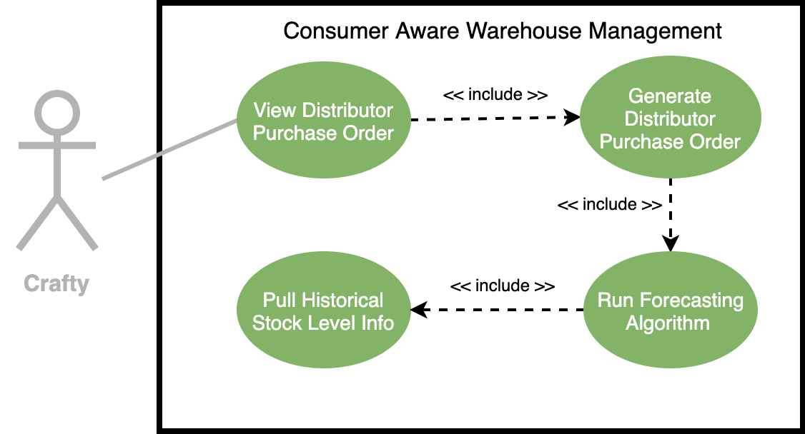
Conceptual Design Diagram - Elijah
SDMay20-25, Consumer Aware Warehouse Management
Notes:
How our solution works, and what it does
-walk through diagram, point out:
-what we are doing
-where/how our system interacts Crafty
-special events, how will they be entered? Will we facilitate that or will Crafty?

Slide 5
Functional Requirements - Jameel
Create User Interface for Viewing Product Orders
Take Input From Crafty Database for Distributor Purchase Order
Predict Optimal Product Orders
Making Data Consumable
Databse Format
Warehouse Inventory History + Stock
SDMay20-25, Consumer Aware Warehouse Management
Notes:
Take data from the Crafty database as input in creating a distributor purchase order
This requirement makes it such that SDMay20-25 software solution will be tied to complying with the format of the current data stored in Crafty’s database.
For each distributor, make predictions about optimal ordering to maintain product warehouse stock for individual goods provided by that distributor based on
Have a user interface for Viewing Product Orders
The Crafty procurement team needs a way to interface with the system tool

Slide 6
Non-Functional
Requirements - Omair
Handle 1200 Stock Keeping Units (SKUs)
Report Generation in a Timely Manner
(< 2 min 90% of the time)
SDMay20-25, Consumer Aware Warehouse Management
Notes:
Handle 1200 SKUs a day, this is how many SKUs that Crafty’s system in place is able to handle in a day
Timely Report Generation.
***Mention SECURITY ***
It's out of scope for two big reasons. Its an internal website (no public interface), and it is a proof of concept.
Jimmy: what is 90% of the time mean?
Explain that every time they are about to place an order they have to run this algorithm to generate the report

Slide 7
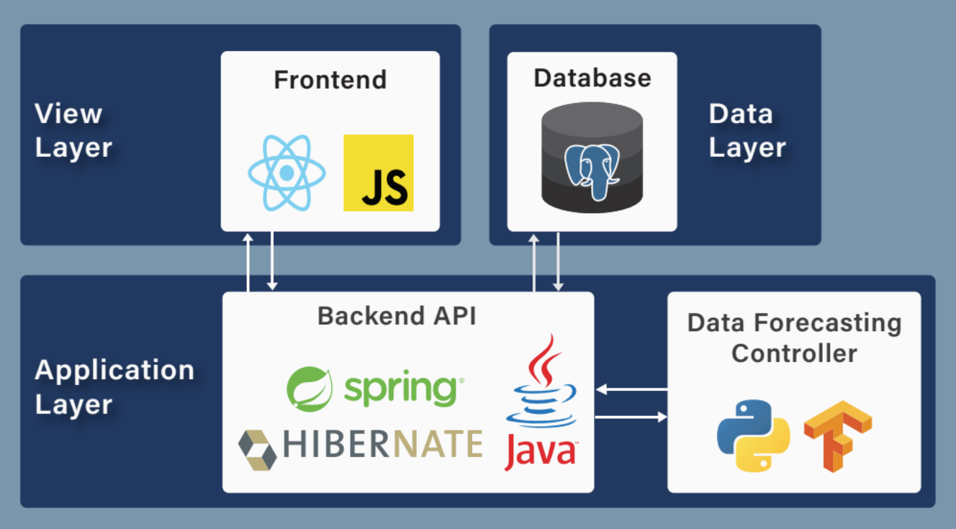
System
Design -
Sam
SDMay20-25, Consumer Aware Warehouse Management
Notes:
Our tech stack will have JavaScript with React framework on the front end; on the backend, we will be using Java with a Spring and Hibernate framework with Python Keras and Tensorflow for the LTSM algorithm; and for the database, we will be using PostgreSQL. We choose JavaScript and React because of the knowledge our team members have with both and the amount of online resources available to support and help. We choose Java with Spring and Hibernate because of the knowledge we possess in these software system and again the online support. We choose Python Keras and Tensorflow for our algorithm because we are comfortable with Python and need the capabilities that Keras and Tensorflow offers. Some of our team members also has past experience with Keras and Tensorflow. We choose PostgreSQL because our client uses PostgreSQL so we can more easily integrate their data into our database. The language is also very similar to MySQL which we have experience with.

Slide 8
API Design
SDMay20-25, Consumer Aware Warehouse Management
Notes:
We will now move onto the API design for the project.

Slide 9
API Design - List of All Endpoints - Andrew
Get Distributor
/distributor/{distributorID}
List All Distributors
/distributors/{regionID}
Get All Distributors Order Schedules
/distributors/scheduleAll/{regionID}
Get Distributor Order Schedule
/distributor/schedule/{distributorID}
List All Distributors Ones with Products
/distributors/withProducts/{regionID}
List All Distributors Ones with Products to Order
/distributors/withProductsToOrder/{regionID}
Get Distributors Products
/distributor/products/{distributorID}
Get Distributor Products with Order Quantity >0
/distributor/products/withPredictions/{distributorID}
List All Regions
/regions
Get Breweries
/breweries/{regionID}
List History of Missed Items
/missedItemsBySku/{skuID}
List Historical Warehouse Inventory Level
/sku_hist/{skuID}
Add a New Prediction Value
/predictions/add
Get Predictions for a Sku
/predictions/sku/{skuID}
SDMay20-25, Consumer Aware Warehouse Management
Notes:
Here is a list of all the endpoints we ended up making for the project. We will walk you through a scenario of the prediction generation and display through the calling of some of these endpoints.

Slide 10
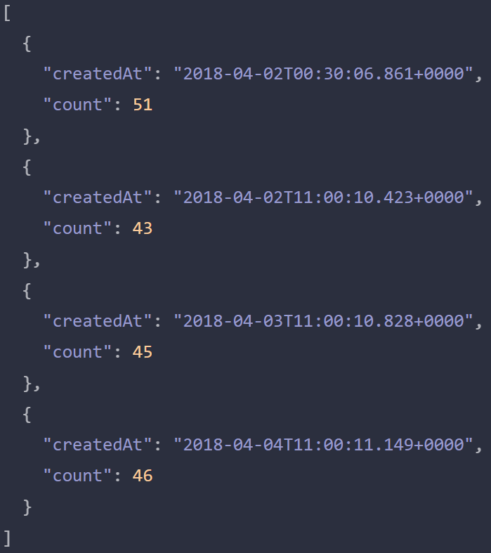
API Design - Historical Warehouse Inventory Level -Andrew
Called to get the historical warehouse inventory level
Used to display on a graph for frontend
Used by algorithm to generate predictions
/sku_hist/{skuID}
SDMay20-25, Consumer Aware Warehouse Management
Notes:
First we start of with the algorithm calling the endpoint to get the historical warehouse inventory for the sku it is making the predictions on. They call the endpoint and are given similar data as displayed to the right, listing a count and the date of the count. The algorithm then uses this data to make their predictions. The front end also calls this endpoint to display a graph of the inventory level over time.

Slide 11
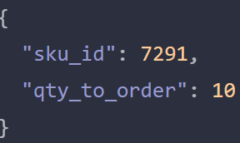
API Design - Add a New Prediction Value - Sam
Make a prediction for Order Quantity
Update the Database
Communicates with the Machine Learning Component
/predictions/add
SDMay20-25, Consumer Aware Warehouse Management

Slide 12
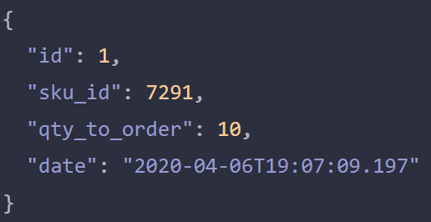
API Design - Get Predictions for a Sku - Omair
All predictions are stored
The most recent prediction for a SKU can be retrieved DB along with the time stamp
Will be displayed on the frontend
/predictions/sku/{sku}
SDMay20-25, Consumer Aware Warehouse Management

Slide 13
Frontend Design
SDMay20-25, Consumer Aware Warehouse Management

Slide 14
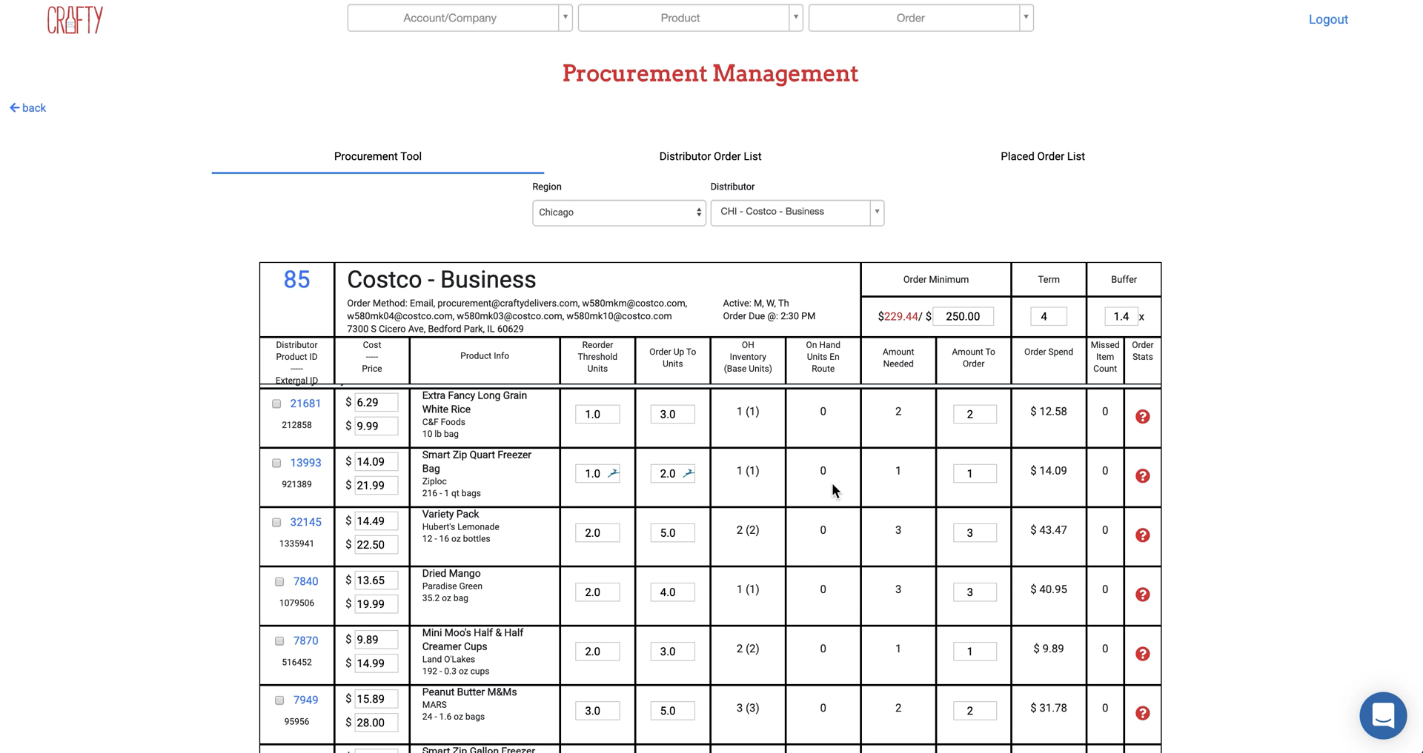
Crafty’s System - Lindsey
1
2
3
4
SDMay20-25, Consumer Aware Warehouse Management
Notes:
Here we see Crafty’s current implementation for their predictions by distributor in the amount to order column. We show this for

Slide 15
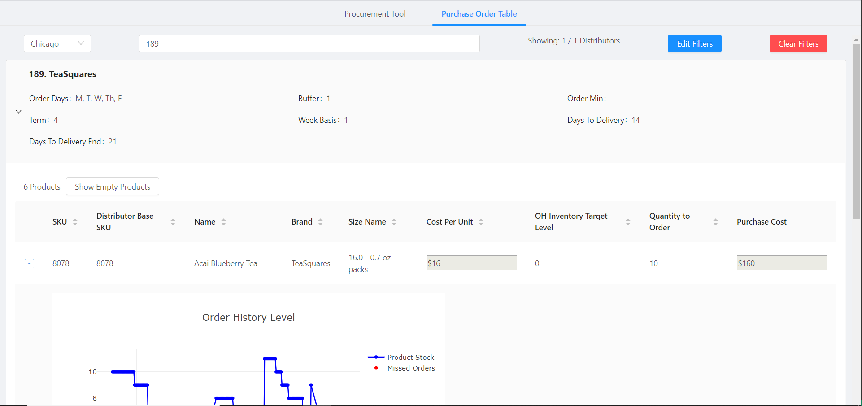
Demo - Lindsey
Link
SDMay20-25, Consumer Aware Warehouse Management
SDMay20-25, Consumer Aware Warehouse Management
Notes:
Showcase our UI
Discuss Results
Discuss Querying & Setup So Far

Slide 16
Machine Learning Design
SDMay20-25, Consumer Aware Warehouse Management

Slide 17
Machine Learning Design - Devin
Long Short Term Memory (LSTM) neural network
Capable of predicting long term and short term trends in data
Created with Keras and Tensorflow
SDMay20-25, Consumer Aware Warehouse Management

Slide 18
Algorithm Test Plan - Devin
SDMay20-25, Consumer Aware Warehouse Management

Slide 19
Test Plan - Algorithm - Elijah
Test SKUs
Missed Sales
Client Order History
SDMay20-25, Consumer Aware Warehouse Management
Notes:
Couldn’t test on all skus, because there’s a lot of them, so we chose a small number of skus to test on.
We tested algorithm accuracy by using a training and testing set, and evaluating based on test MSE.
We would have liked to assess algorithm accuracy based on product demand and number of sales that were actually missed, compared to the number of sales our prediction would have missed. Unfortunately the structure of the database made product demand too difficult to acquire, under the time constraints, so we had to settle with the MSE assessment.
---------------------------------------------------------------------------------------------------------------------------------------------------------------------------------------------------------------------------------------
most clear metric we had was missed sales history, but it could encourage over-ordering, and there were very few instances of missed sales for many skus.
we also didn't have client order history accessible, so it wasn't possible to calculate demand, so we couldn't really test the accuracy of our alg. Crafty has begun their own attempt on improving their algorithm, and they utilize a concept of 'safety stock' which is a concept that we didn't have while we were developing the algorithm.
Client order history - crap DB organization, and time constraints forced us to pivot to get shit working together instead of ironing out testing
Clear this up

Slide 20
Test Plan
Frontend - Jameel
Manual testing of components upon completion
Using Postman Collection to check API status and return values
Using Developer Tools to test XHR Requests (time and deserialization to objects)
Backend - Sam
Manual Tests
Create SQL Queries
Create Spring Endpoints
Compare Endpoint results with SQL results
CI/CD
Compile and Deploy to Server
SDMay20-25, Consumer Aware Warehouse Management

Slide 21
Engineering Standards and Design Practices - Sam
Code Review
Xtreme Programming
Model View Controller
SDMay20-25, Consumer Aware Warehouse Management

Slide 22
Lessons Learned - Everyone
Backend - Omair
PostgreSQL databases
Working with existing databases can be very difficult to find where and what the data is
Complex queries with Spring
API design to support a flexible frontend
Planning and task distribution is important
Frontend
React Framework
API Integration
Robust API Integration on Frontend
Peer Programming while Teaching
Algorithm
Working with LSTM neural networks
Using Tensorflow and Keras
Data is important
Amount of data
Knowledge of data
SDMay20-25, Consumer Aware Warehouse Management

Slide 23
Thank you!
Questions?
SDMay20-25, Consumer Aware Warehouse Management

Slide 24
Existing Approaches 1 (Learning Based Approach)
Input Variables
Past Sales
Weather
Travel Time of Product
Advantages
Better Prediction of Demand
Lowers Missed Sales
Disadvantages
Amount of Resources
Relation to Our Solution
Past Sales Data
Shipping Time
Differentiation From Our Solution
Too Many Input Variables
SDMay20-25, Consumer Aware Warehouse Management
Notes:
During research a couple solutions were found on the market. We saw two endpoints of products available. A machine or deep learning approach, that is being used by Walmart, that takes everything that could affect the sales of a product from past sales to weather like if it’s going to be cloudy steaks sell more than hamburgers. It also takes into consideration the time it takes for a product to arrive and the store. Advantages for this type of system is that it is efficient because it would better predict the demand of a product and make missed sales lower. Disadvantages of this system is the amount of resources it takes to build and maintain it. This relates our solution because it takes into consideration past sales data and the time it takes to get the product to the product warehouse. It is different from our solution because the above solution takes in more factors like weather.

Slide 25
Existing Approaches 2 (Regression Based Approach)
Input Variables
Past Sales
Seasonal Changes
Advantages
Little Amount of Resources
Disadvantages
Can’t Handle Spikes in Demand
Doesn’t Figure in Shipping Time
Relation to Our Solution
Past Sales Data
Differentiation From Our Solution
Doesn’t Figure in Shipping Time
SDMay20-25, Consumer Aware Warehouse Management
Notes:
On the other end was a simple Excel linear regression approach, where it can predict the demand of a product based on past sales and seasonal changes. Advantages to this is system is the low amount of resources to maintain and build. The disadvantages to this system are that it doesn’t take into consideration spikes in demand due to factors that aren’t based on past sales, such as weather, and it doesn’t figure in the time it takes to ship a product. This relates to our solution because it takes into consideration past data. It differs from our solution because the above solution doesn’t take into consideration the shipping time to get the product to the product warehouse.

Slide 26
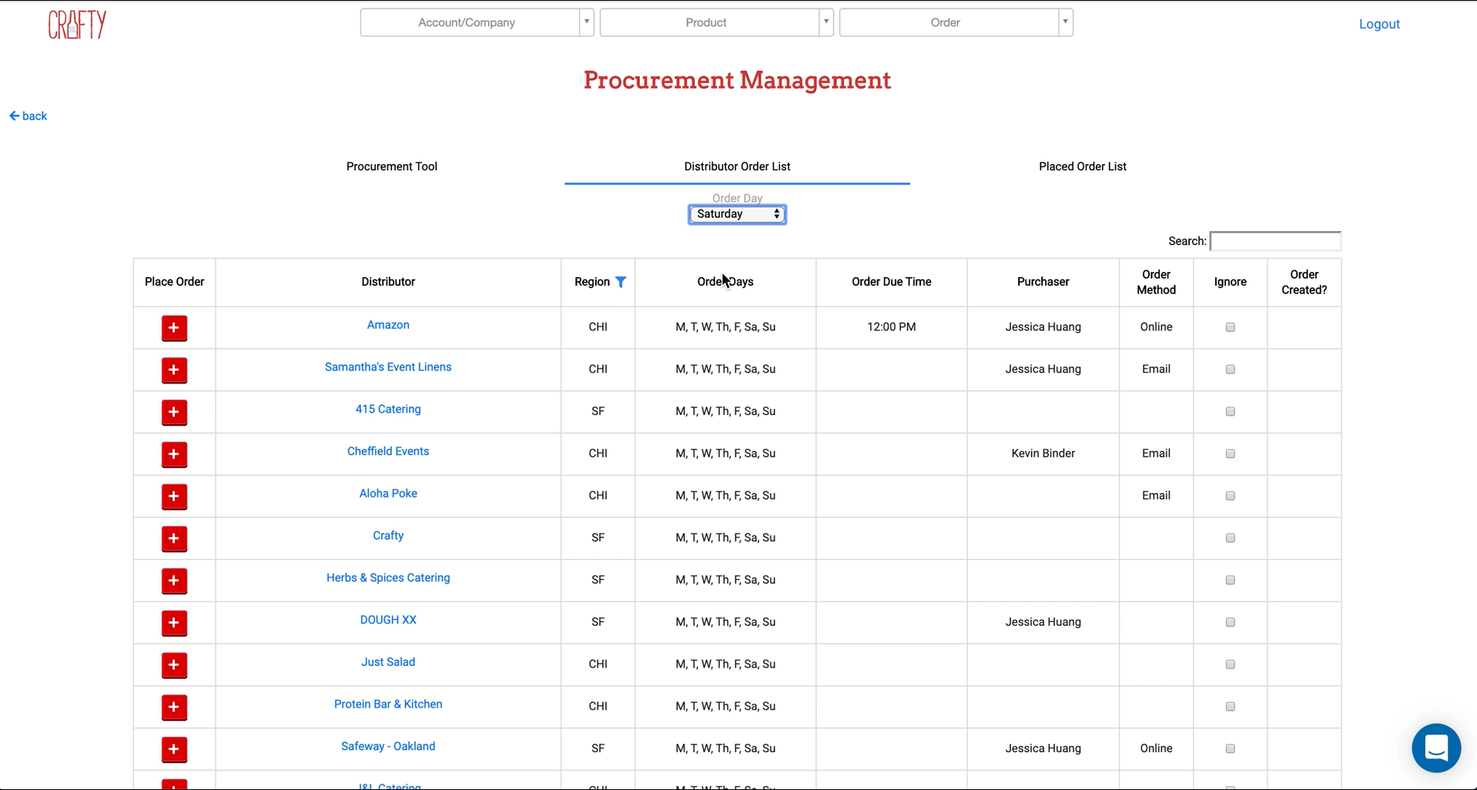
Distributor Order List

Slide 27
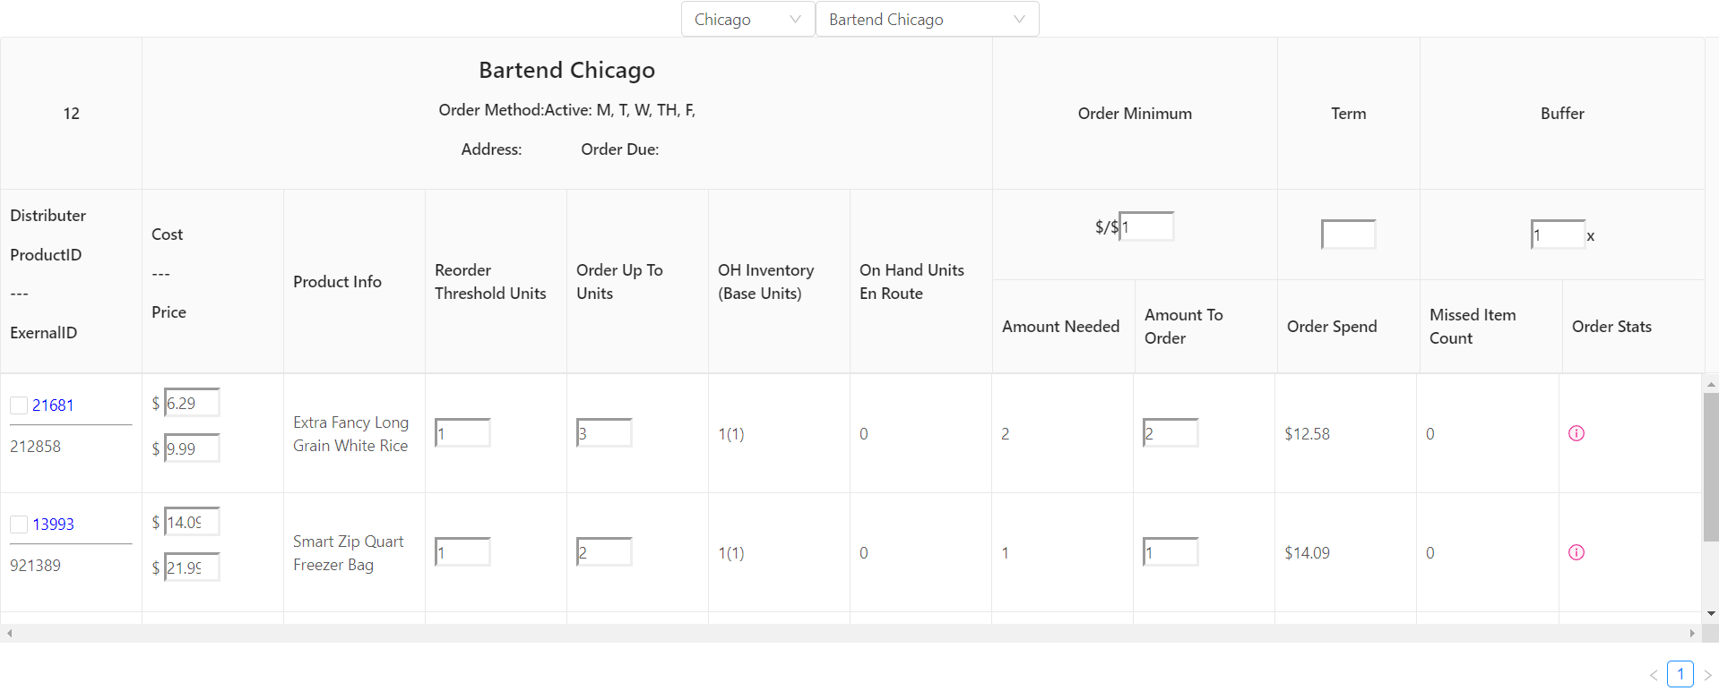
Implementation

Slide 28
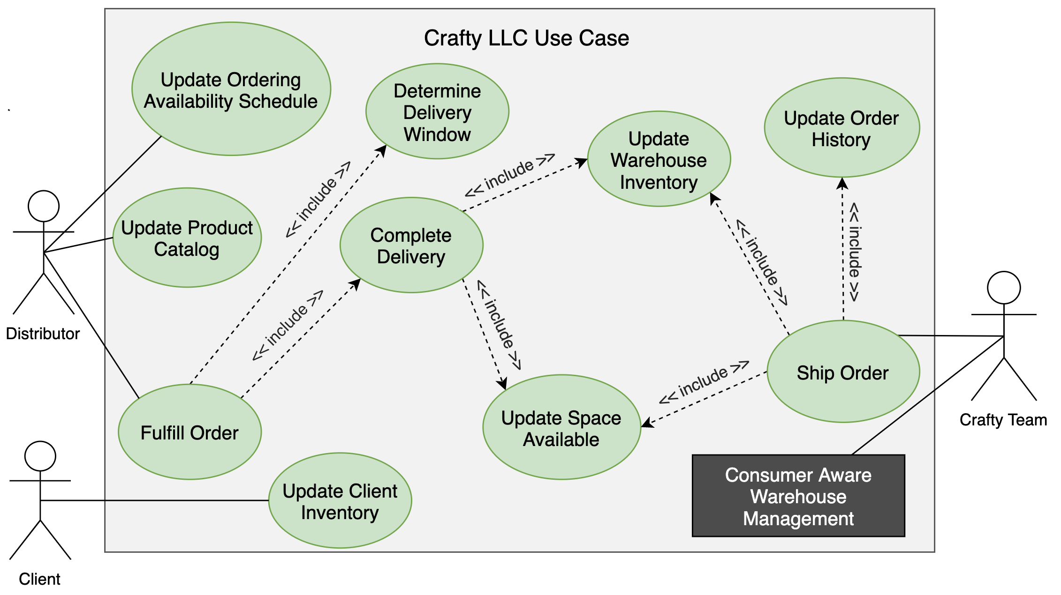

Slide 29
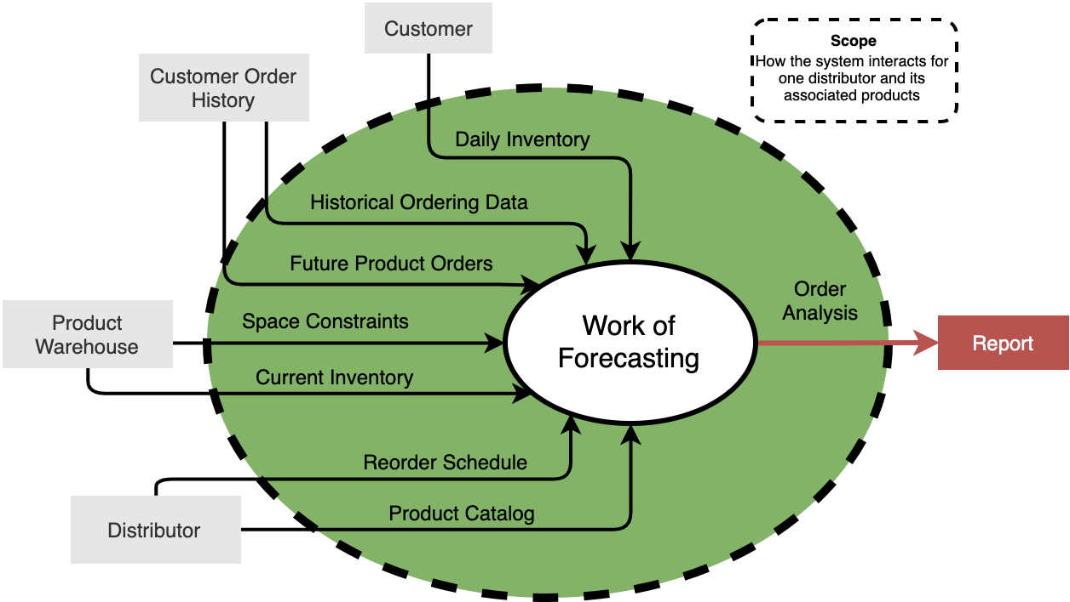
Conceptual Sketch
SDMay20-25, Consumer Aware Warehouse Management
Notes:
Based on the input variables shown previously, we have created a context diagram to provide scope for the project and show how the data flows to and from the adjacent systems, which are the categories of input variables that directly influence the work of forecasting. (systems, people, or work areas that the WoF depends on and produce for/influences). The scope here is how the system interacts for one selected distributor and its associated products. You can see that the forecasting algorithm will take into consideration input variables from customer order history which includes future product orders and historical ordering data, product warehouse data such as space constraints and current inventory, the daily inventory of each customer, and distributor information such as the products that they have available in the catalog which will account for seasonal items and pricing and the reorder schedule which will tell us how often we can order from the distributor and how long it takes for the product to be delivered. All of these input variables will be pulled from the Crafty database and be input into the forecasting algorithm to generate a report of what Crafty should order from that distributor.
As we see in the diagram, we understand Crafty through three users interacting with multiple, connected systems.
The Distributor takes care of placing orders, updating product catalogs, and updating the order availability schedule.
The Client takes care of updating their own inventory
The Crafty Team ships orders
We see our project fitting into the use case of Crafty though providing prediction analytics for the Crafty team.
...

Slide 30
Project Plan - Tasks
Project Planning Tasks
Everyone
Assigned To
Frontend Tasks
Frontend Team
(EB, JK, LS)
Assigned To
Backend Tasks
Backend Team
(AS, OI, SS)
Assigned To
SDMay20-25, Consumer Aware Warehouse Management
Notes:
Transition: Once a our milestones were set in place we could then accurate generate tasks.
Tasks were split into three categories: requirements & project planning, frontend, backend
As stated previously, the big focus was project planning and that involved the entire group
After we completed our Proposed Design (as seen in the slide previously) we split of into two teams frontend consisting of Elijah, Jameel, and Lindsey and backend consisting of Sam, Andrew and myself
It is important that our tasks were completed synchronously meaning that frontend and backend are roughly on the same page
Make note: that frontend will shift merge into backend

Slide 31
Project Plan - Schedule / Milestones
September 30
October 31
November 30
January 31
February 29
March 31
April 30
Finalized Project Plans
Finalized Project Architecture and Initial Tech Stack
Methodology Selection and Tools
Testing Framework
Alpha Version of the Software
Unit Testing, Validation, Beta
Integration Testing, Finalize Solution, Report
SDMay20-25, Consumer Aware Warehouse Management
Notes:
Transition: From our requirements we created these monthly milestones early on into the semester.
These milestones are based off our development process as our first semester was spent on requirement analysis and design and our second semester will include implementation and testing.
Currently we have completed our november milestone which was finalizing our tools for the Software Solution.
Our next semester entails implementation of our proposed solution. Testing into Alpha then Beta then Final software solution

Slide 32
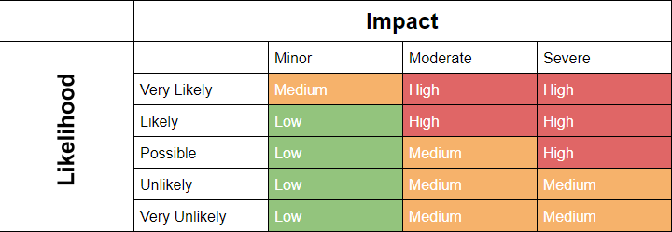
Project Plan - Risks
Inaccurate results
Results not clearly understood
Steep learning curve
SDMay20-25, Consumer Aware Warehouse Management
Notes:
Transition: One of the first tasks worked on early in our planning phase was assessing the potential risks when working on this project.
Here is a risk matrix that our group created. A risk matrix categorized a risk based on its likelihood and the impact it will have. On this slide, there are three risks we have identified as a “high” risk to our project
The first risk deals with inaccurate results. Crafty themselves has a solution in place, but they would like one that is more reliable and can save them more money in the long run. This risk occurs when our solution does not perform better than Crafty’s
The second risk is that the results are not clearly understood. Our software solution outputs a distributor purchase order, and it is vital that Crafty understands why our algorithm behaves the way it does.
The final high risk is the steep learning curve. Our project introduces a lot of technologies that we have not worked on previously, so it is crucial to our success that we choose technology that is well documented.
The mitigation plan consists of:
Jimmy: worst thing is that can come out of this is an algorthim that seems correct but is reporting the wrong thing. How will we prove correctness? Include a bullet under mitigation plan

Slide 33
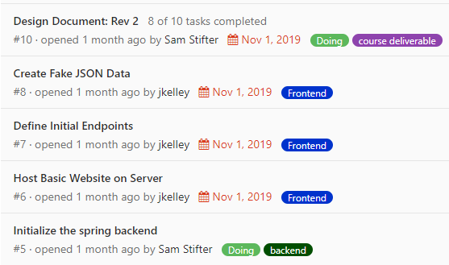
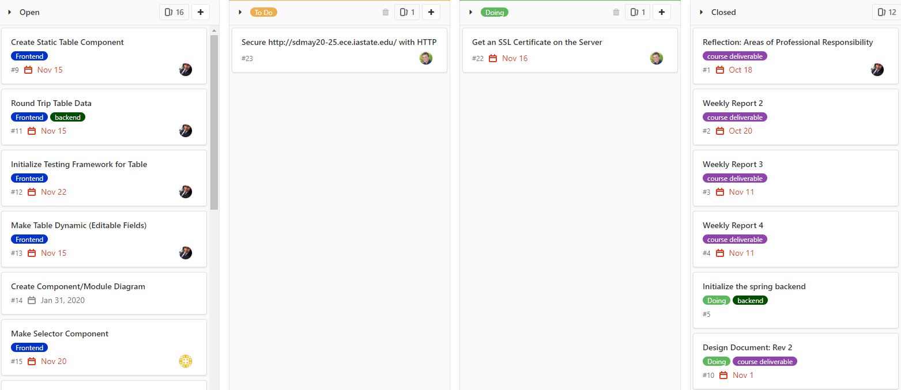
Project Plan - Progress Metrics
SDMay20-25, Consumer Aware Warehouse Management
Notes:
Transition: To track our progress through our tasks we will use GitLab issues.
Each task identified will be translated into an issue in GitLab
Issues in gitlab are well organized and include a due date, assignees and are assigned to a milestone
Gitlab issues can also be viewed in a board view which helps us visualize which issues are open, closed, doing and done
Slack is used as informal communication between the team, any relevant information from slack can be copied to gitlab
TODO->add a better image

Slide 34
Project Vision - Lindsey
Price Trends
Distributor Schedules
Client Trends
Missed Sales
Crafty desires a forecasting algorithm for inventory management that automates reordering for warehouse stock
Warehouse Space
Seasons
Expiration Dates
Historical Ordering Data
New Customer Orders
Inventory Thresholds
SDMay20-25, Consumer Aware Warehouse Management
Notes:
In response to these areas of improvement, Crafty desires a forecasting algorithm that is going to help automate reordering by determining which products should be reordered. Crafty has a current solution that takes into consideration historical ordering data which is how much of each product is consumed over a period of time, distributor schedule and lead time, missed sales, and client inventory thresholds. Our team is looking to incorporate additional variables, with the major emphasis being on needs of new customers, client trends, warehouse space, and product expiration dates.

